Slide 1


A Pokemon Database
By Sarah Winegar

Slide 2
Why Pokemon?
Because… childhood!
Lots of fun gathering data.
Easily relatable to project requirements.

Slide 3
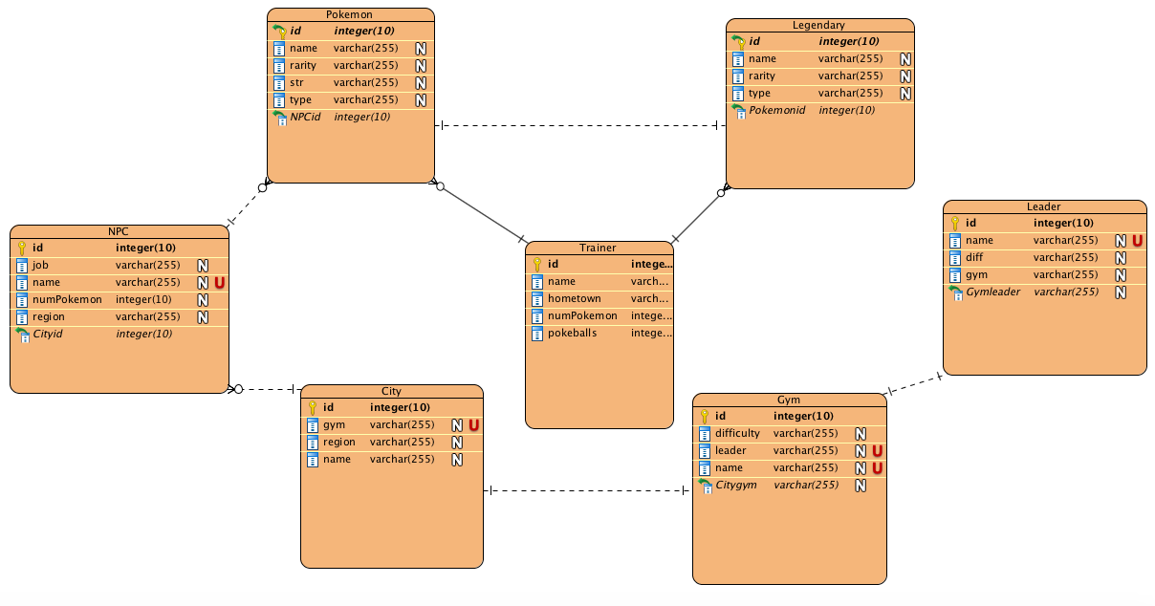
ER Diagram

Slide 4
What’s the Normalization?
3.5 Normal Form, or, BCNF
Functional dependency on Gym and Leader (Gym needs Leader)
Function dependency on City and Gym (Gym needs City)

Slide 5
Integrity Enforcement
All ID’s are primary keys that auto-increment
Meaning, no tuple can have a duplicated ID in their respective table

Slide 6
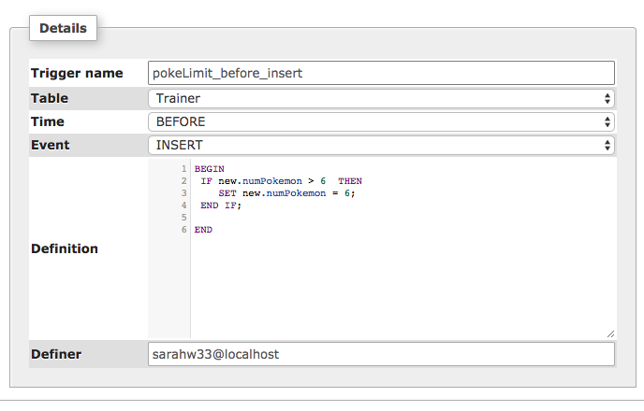
Trigger

Slide 7
Isolation Level
Default mySQL Serializable
No chance of transaction times being too close together, resulting in a faulty database
Basically i’m not making a bank database, it’s just some light hearted pokemon fun :)

Slide 8
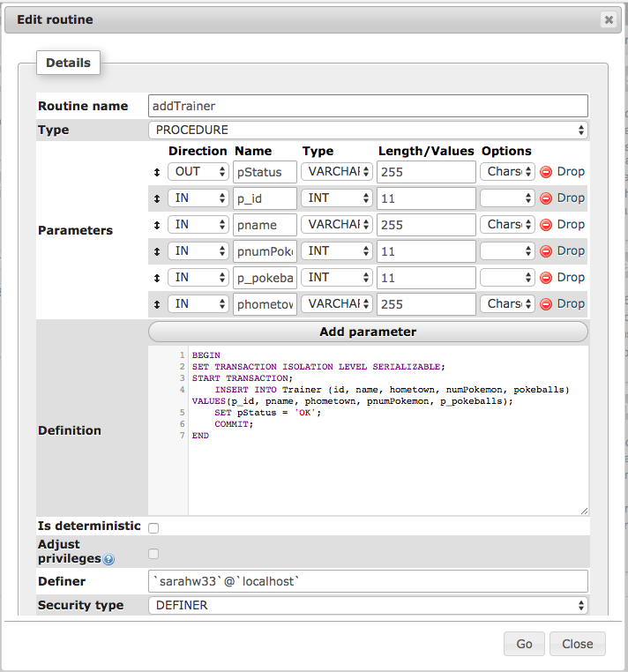
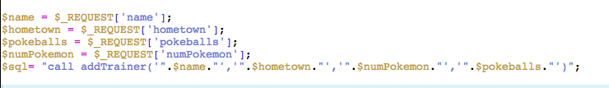
Procedure 1

Slide 9
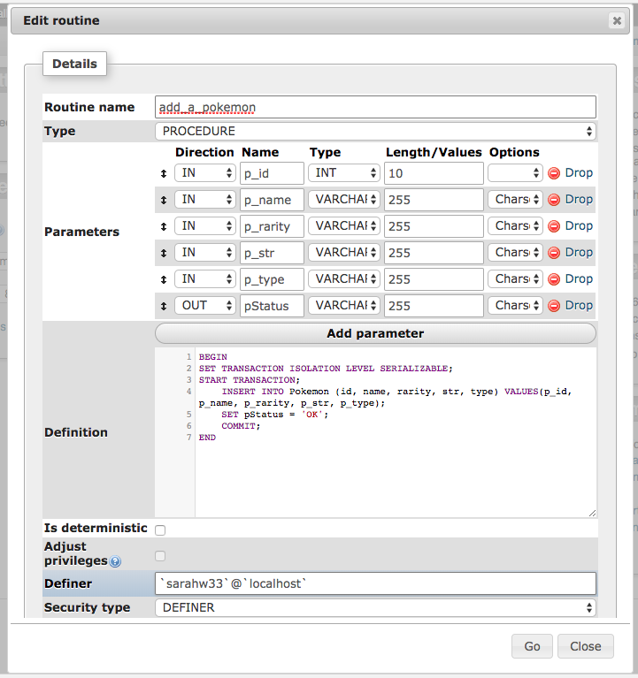

Procedure 2

Slide 10
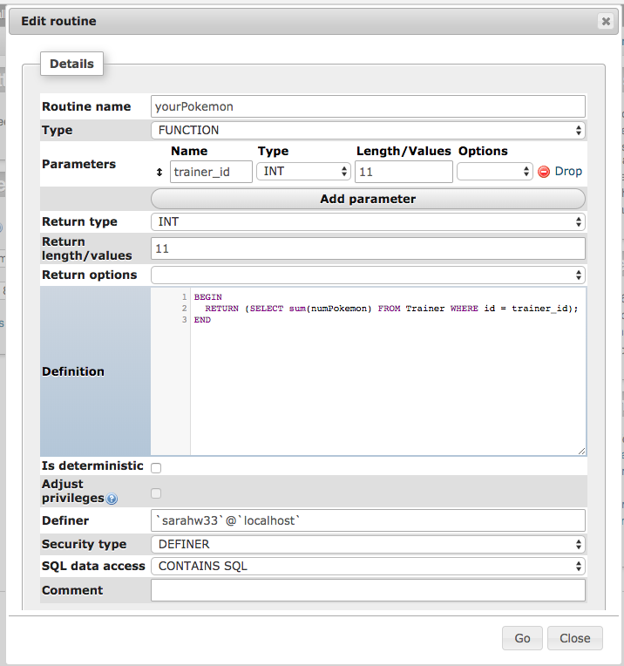
Function 1

Slide 11
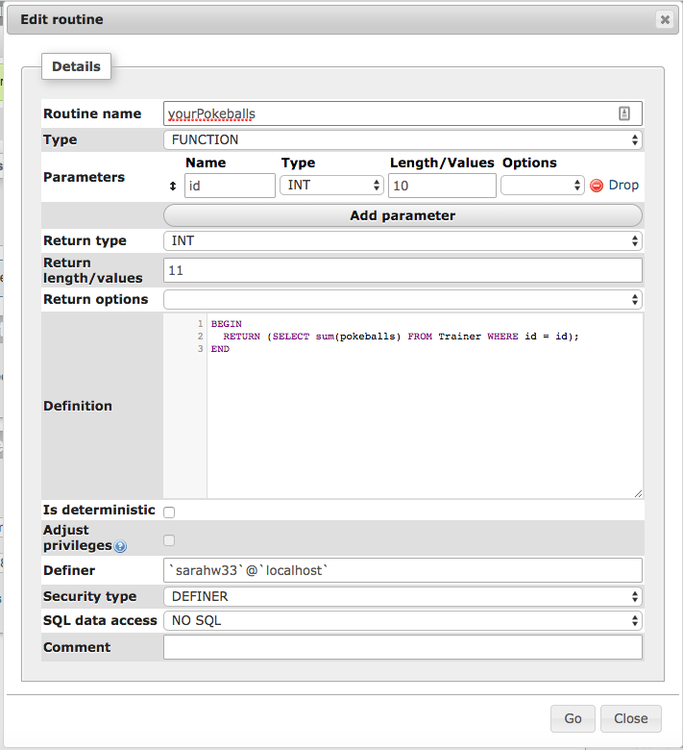
Function 2

Slide 12
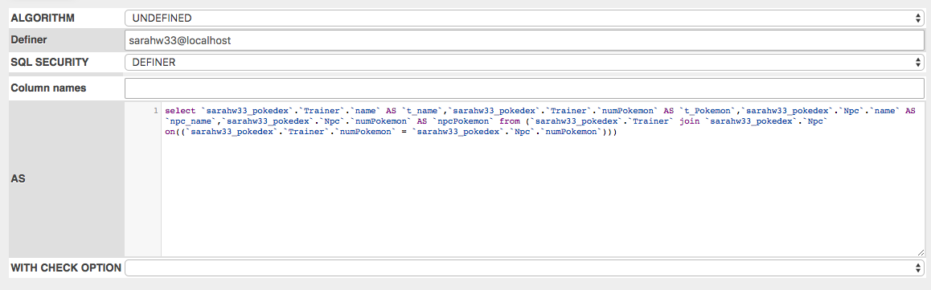
View/Report 1

Slide 13
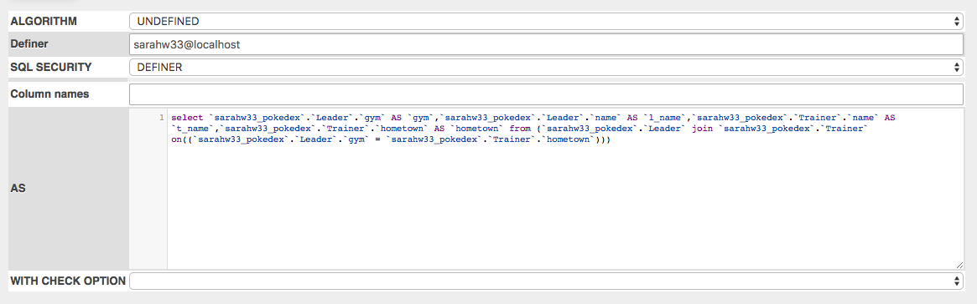
View/Report 2

